Slide 1
The Oxford Artificial Intelligence Summit 2025: Autonomous AI Agents
Full Code Assignment

Slide 2
Prerequisites
OpenAI API Access: An OpenAI account with API key (for calling language models and using OpenAI-hosted tools).
Python Basics: Familiarity with Python programming (the SDK uses async calls).
LLM and Function-Calling Knowledge: Understanding of prompt design and how large language models can call functions/tools.
Google Account: Required to use Google Colab for running the code (no local installation needed).

Slide 3
Assignment Task
Each group will choose one Pattern to implement : (Deterministic, Agents as Tools, or Parallel Execution)
Choose a Scenario from the list of use cases.
Build Baseline Solution: One or more agents configured to solve the task (even if output is imperfect initially).
Use Tools: Integrate at least one prebuilt function/tool in the agent flow (web search, mcp, etc. to extend capabilities).
Iterate Improvements: Refine prompts/config to improve results.
Justify & Analyze: Explain why the pattern was appropriate, and how each iteration improved the agent’s performance.

Slide 4
Use cases
1. Healthcare – Patient Journey Optimization
Use Case: Analyzing patient flow from admission to discharge.
Goal: Identify bottlenecks (e.g., long wait times), unnecessary steps, or re-admissions to improve service delivery and reduce costs.
2. Manufacturing – Production Line Efficiency
Use Case: Tracking production workflows from raw materials to finished goods.
Goal: Detect deviations, delays, or inefficiencies in assembly lines to enhance throughput and reduce waste.
3. Financial Services – Loan Application Processing
Use Case: Monitoring the steps from loan application to approval or rejection.
Goal: Ensure compliance, reduce delays, and spot fraudulent patterns or unnecessary rework.
4. E-commerce – Order-to-Cash (O2C) Process
Use Case: Mapping customer order fulfillment from purchase to payment.
Goal: Reduce order delays, improve customer satisfaction, and optimize cash flow.

Slide 5
Use cases
5. Logistics – Shipment and Delivery Tracking
Use Case: Analyzing logistics operations including warehouse handling, dispatch, and delivery.
Goal: Minimize delivery delays, improve routing efficiency, and manage supply chain risks.
6. Public Sector – Permit and License Approvals
Use Case: Monitoring application processes for building permits, business licenses, etc.
Goal: Streamline public services, reduce citizen wait times, and increase transparency.
7. IT Service Management – Incident Resolution
Use Case: Mapping IT incident management (e.g., ticket creation → triage → resolution).
Goal: Reduce Mean Time to Resolution (MTTR), identify recurring issues, and optimize service desk workflows.

Slide 6
Use cases
8. Telecommunications – Customer Onboarding
Use Case: Tracking steps for onboarding new subscribers or activating services.
Goal: Ensure timely activations, reduce churn, and uncover causes of failed onboarding attempts.
9. Insurance – Claims Processing
Use Case: Analyzing the end-to-end claims handling process.
Goal: Detect fraud, accelerate payouts, and ensure regulatory compliance.
10. Education – Student Enrollment and Course Progression
Use Case: Mapping student actions from enrollment, registration, to course completion.
Goal: Identify drop-out risks, improve academic advising, and optimize program structure.

Slide 7
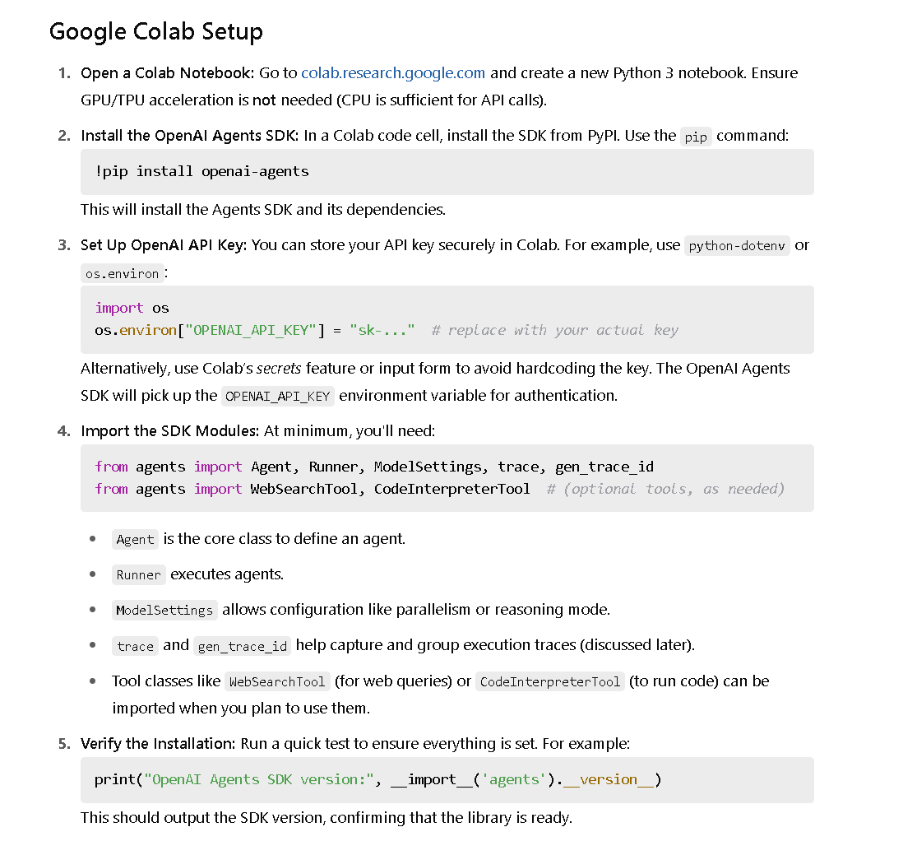
Google Colab setup

Slide 8
Agents - Basic configuration
The most common properties of an agent you'll configure are:
instructions: also known as a developer message or system prompt.
model: which LLM to use, and optional model_settings to configure model tuning parameters like temperature, top_p, etc.
tools: Tools that the agent can use to achieve its tasks.
from agents import Agent, ModelSettings, function_tool
@function_tool
def get_weather(city: str) -> str:
return f"The weather in {city} is sunny"
agent = Agent(
name="Haiku agent",
instructions="Always respond in haiku form",
model="o3-mini",
tools=[get_weather],
)
Agents - OpenAI Agents SDK

Slide 9
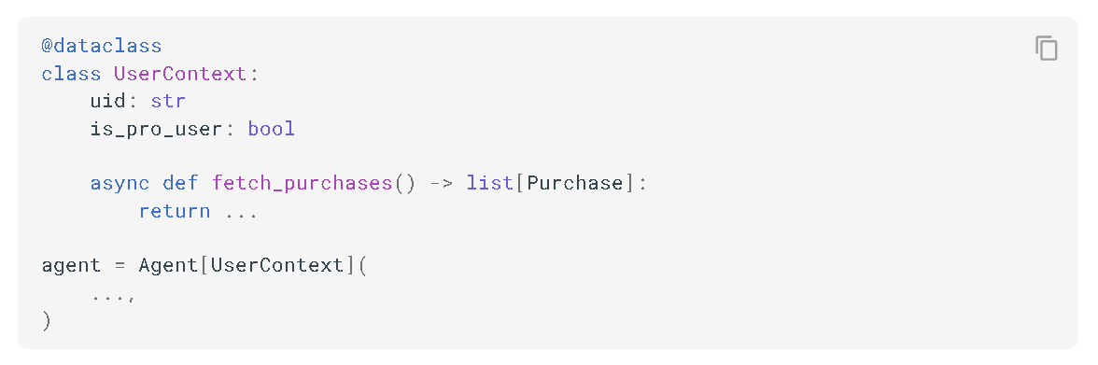
Agents - Context
Agents are generic on their context type. Context is a dependency-injection tool: it's an object you create and pass to Runner.run(), that is passed to every agent, tool, handoff etc, and it serves as a grab bag of dependencies and state for the agent run. You can provide any Python object as the context.
Agents - OpenAI Agents SDK

Slide 10
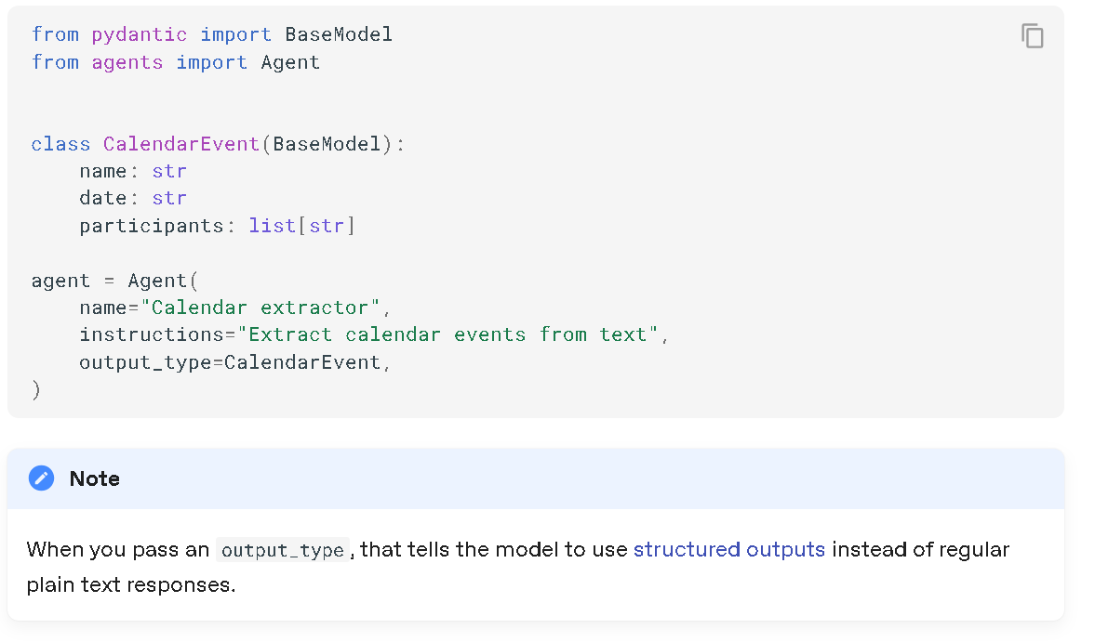
Agents - Output Types
By default, agents produce plain text (i.e. str) outputs. If you want the agent to produce a particular type of output, you can use the output_type parameter. A common choice is to use Pydantic objects, but we support any type that can be wrapped in a Pydantic TypeAdapter - dataclasses, lists, TypedDict, etc..
Agents - OpenAI Agents SDK

Slide 11
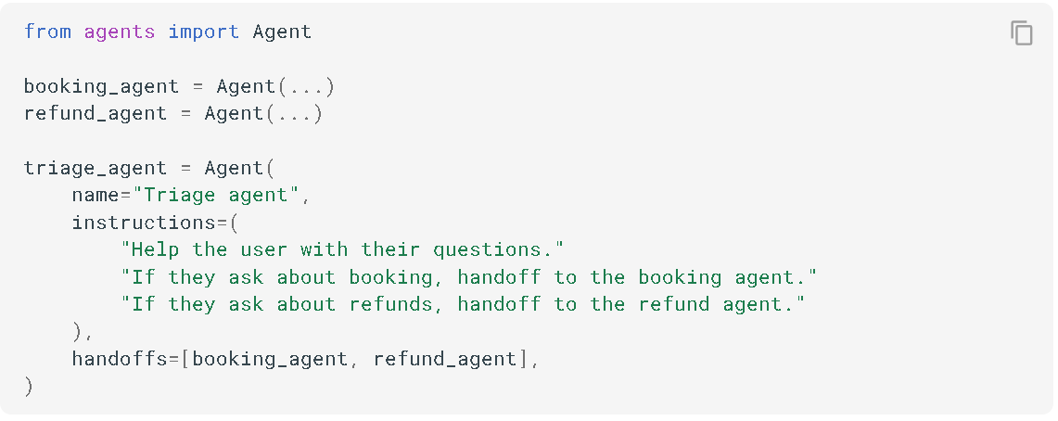
Agents - Handoffs
Handoffs are sub-agents that the agent can delegate to. You provide a list of handoffs, and the agent can choose to delegate to them if relevant. This is a powerful pattern that allows orchestrating modular, specialized agents that excel at a single task. Read more in the handoffs documentation.
Agents - OpenAI Agents SDK

Slide 12
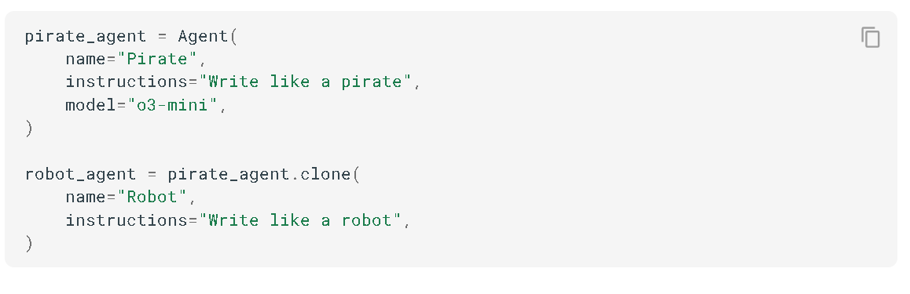
Agents - Cloning
By using the clone() method on an agent, you can duplicate an Agent, and optionally change any properties you like.
Agents - OpenAI Agents SDK

Slide 13
Agents - Forcing tool use
Supplying a list of tools doesn't always mean the LLM will use a tool. You can force tool use by setting ModelSettings.tool_choice. Valid values are:
auto, which allows the LLM to decide whether or not to use a tool.
required, which requires the LLM to use a tool (but it can intelligently decide which tool).
none, which requires the LLM to not use a tool.
Setting a specific string e.g. my_tool, which requires the LLM to use that specific tool.
Note:
To prevent infinite loops, the framework automatically resets tool_choice to "auto" after a tool call. This behavior is configurable via agent.reset_tool_choice. The infinite loop is because tool results are sent to the LLM, which then generates another tool call because of tool_choice, ad infinitum.
If you want the Agent to completely stop after a tool call (rather than continuing with auto mode), you can set [Agent.tool_use_behavior="stop_on_first_tool"] which will directly use the tool output as the final response without further LLM processing.
Agents - OpenAI Agents SDK

Slide 14
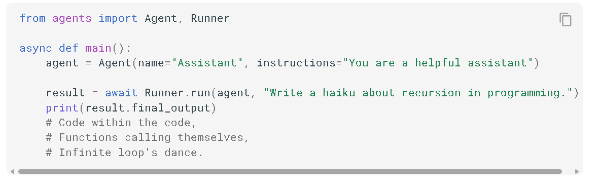
Agents - Running Agents
You can run agents via the Runner class. You have 3 options:
Runner.run(), which runs async and returns a RunResult.
Runner.run_sync(), which is a sync method and just runs .run() under the hood.
Runner.run_streamed(), which runs async and returns a RunResultStreaming. It calls the LLM in streaming mode, and streams those events to you as they are received.
Running agents - OpenAI Agents SDK

Slide 15
Agents - agent loop
When you use the run method in Runner, you pass in a starting agent and input. The input can either be a string (which is considered a user message), or a list of input items, which are the items in the OpenAI Responses API.
The runner then runs a loop:
We call the LLM for the current agent, with the current input.
The LLM produces its output.
If the LLM returns a final_output, the loop ends and we return the result.
If the LLM does a handoff, we update the current agent and input, and re-run the loop.
If the LLM produces tool calls, we run those tool calls, append the results, and re-run the loop.
If we exceed the max_turns passed, we raise a MaxTurnsExceeded exception.
Running agents - OpenAI Agents SDK

Slide 16
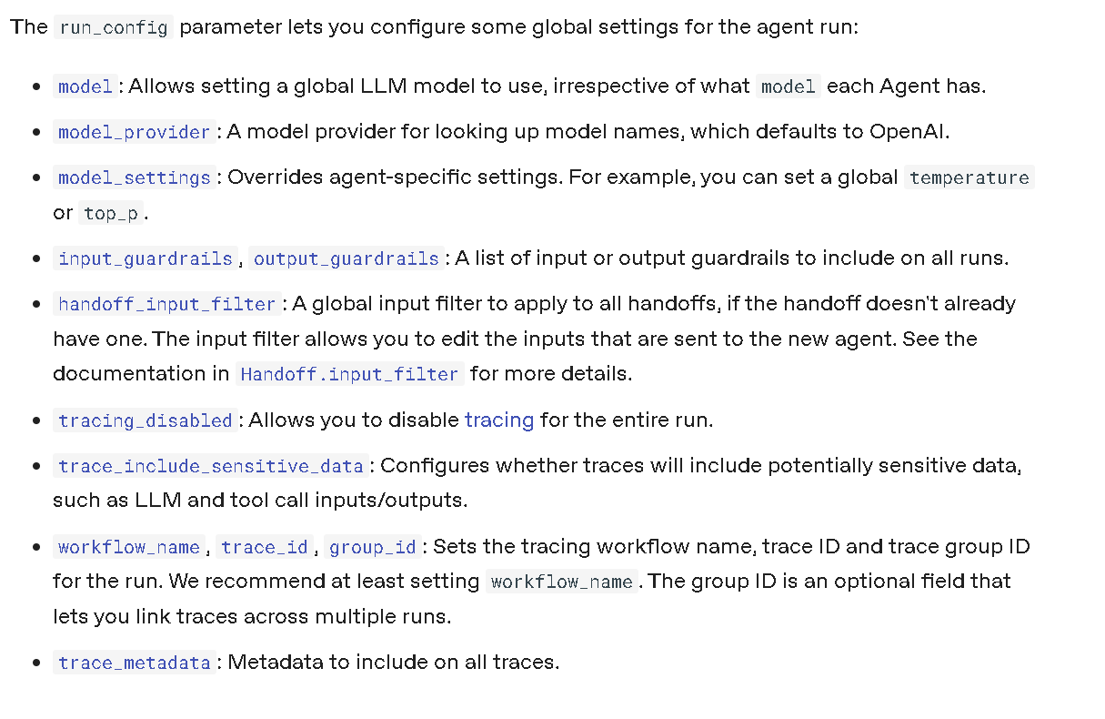
Agents - Run Config
Running agents - OpenAI Agents SDK

Slide 17
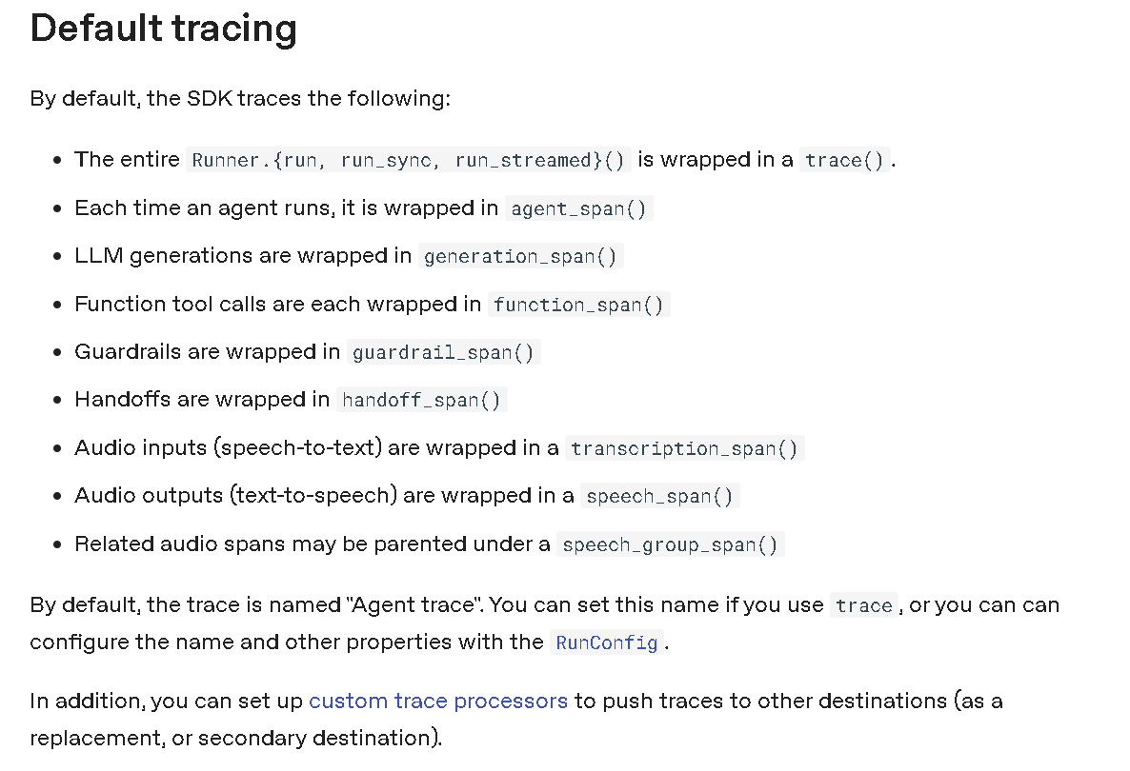
Agents - Tracing
Tracing - OpenAI Agents SDK

Slide 18
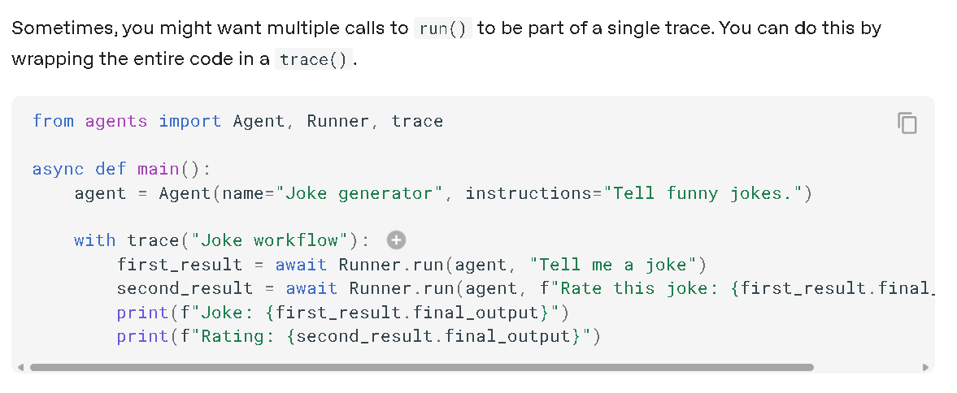
Agents - Higher level traces
Tracing - OpenAI Agents SDK

Slide 19
Understanding Agent Design Patterns
The OpenAI Agents SDK supports multiple agent orchestration patterns. Each pattern defines how tasks are broken down and how multiple agents might interact. Here we explain the three official patterns you can choose from, along with when to use each:
Deterministic Workflows
Agents as Tools
Parallel Agent Execution

Slide 20
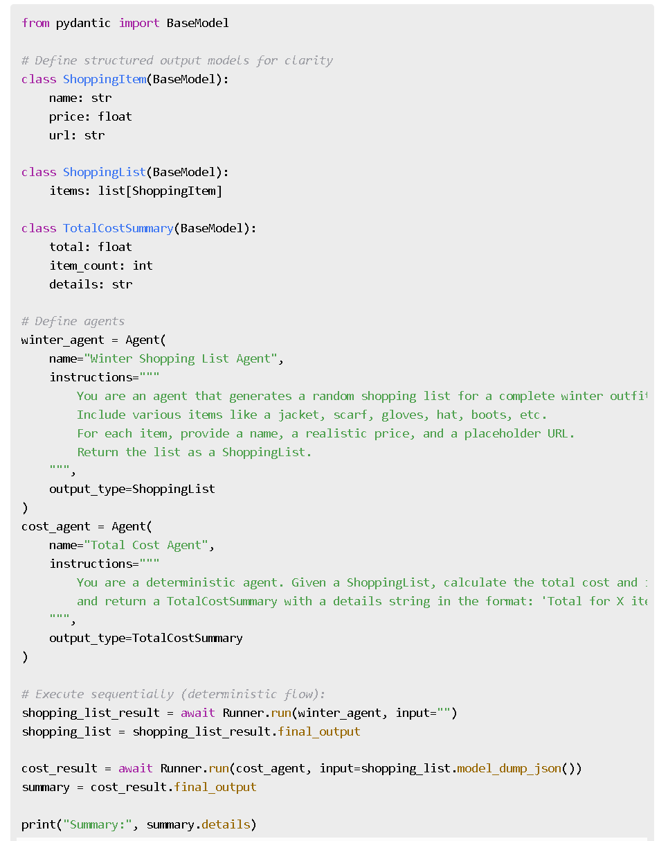
Deterministic workflows Design Pattern
Deterministic workflows are straightforward, fixed sequences of steps to accomplish a task. In this pattern, the flow of execution is predetermined by code (not by the LLM's reasoning). One agent’s output feeds directly into the next agent, and so on, in a linear pipeline.
Characteristics: A fixed sequence of operations; each step is well-defined and does not vary. No branching logic based on content – it's always "do X, then Y, then Z".
When to Use: Ideal when the problem can be broken into clear sub-tasks and the path to the goal is known in advance. If the end goal and method are certain, a deterministic chain is both simpler and more predictable in terms of cost, speed, and outcome.
Example Use-Case: Shopping scenario– first generate a winter shopping list, then have another agent calculate the total cost. The steps and their order do not change.

Slide 21
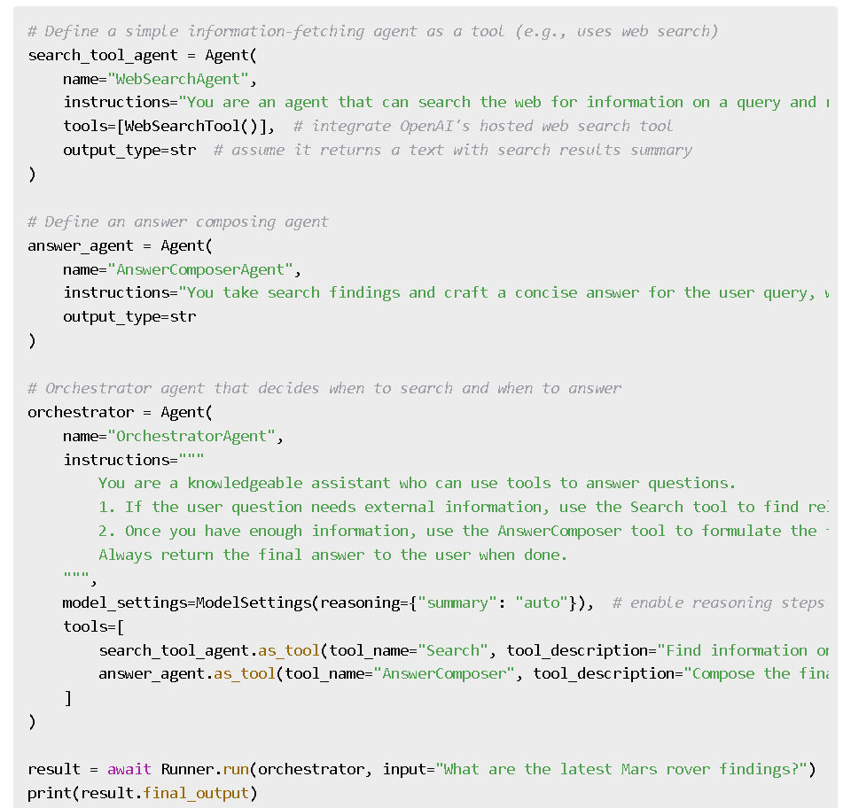
Agents as Tool Design Pattern
The Agents-as-Tools pattern uses a central orchestrator agent that can invoke other specialist agents as tools to complete sub-tasks, without handing over full control. Unlike deterministic pipelines, the orchestrator decides at runtime which agent/tool to call next based on intermediate results or the problem’s needs.
Characteristics: The orchestrator agent never relinquishes control; it uses other agents like function calls. The sequence of calls can vary: which sub-agent is invoked, how many times, and in what order can depend on the content of the task and partial results. This often involves the main agent doing some reasoning/planning step (sometimes called a "planner" agent).
When to Use: Use this when you have a complex, open-ended task requiring multiple skills or tools, and the exact steps aren’t a straight line. The LLM can plan and select the appropriate tools/agents dynamically. It’s great for scenarios where different inputs may require different workflows, or iterative refinement is needed.
Example Use-Case: Research & Synthesis Agent an agent that given a query, decides to use a Web Search tool if needed, then perhaps a Answer Composer agent as tool, etc., to produce an answer.

Slide 22
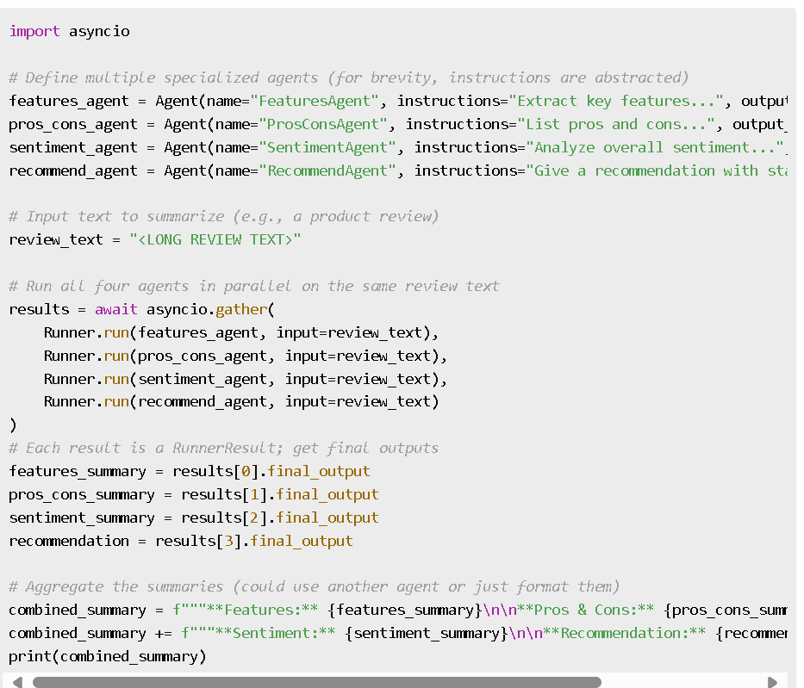
Parallel Agent Execution Design Pattern
The Parallel Execution pattern involves running multiple agents simultaneously (concurrently) to speed up processing or generate diverse results that can later be merged. Instead of sequential or orchestrated calls, parallel agents work independently on subtasks, and then their outputs are combined by a final step.
Characteristics: Independent agents address different aspects of a task (or the same task in different ways) at the same time, often using Python concurrency (e.g., asyncio.gather) to run them in parallel threads or async tasks. There is typically an aggregator agent or code that waits for all results and then composes a final result.
When to Use: Best when sub-tasks do not depend on each other’s immediate results (no need to wait for one agent before starting another). This pattern shines for speeding up multi-part problems (reducing latency by concurrent execution) or for exploring variations (having multiple agents attempt the same task in different ways and then picking the best result).
Example Use-Case: For instance, imagine we want to summarize different aspects of a product review (features, pros/cons, sentiment, etc.) in parallel, then merge them:.
Notes:
Why "Agents as Tools"? This pattern adds flexibility. The LLM (within the orchestrator agent) can conditionally use any of the provided tools/agents based on the situation – e.g., skip a step if it's not needed, repeat a tool if results are insufficient, or handle errors. It essentially treats sub-agents like function calls, without handing off full control as a deterministic handoff would. This is useful for orchestration where the agent might loop through tools until some success criteria is met, making the workflow more adaptive.

Slide 23
Submission Process
Deadline: 6 July 2025 – ensure your notebook is ready by then.
Submission Method: Upload your Colab notebook (export as .ipynb or share the link with edit access) and email to ayse.mutlu@conted.ox.ac.uk
What to Include: The notebook should contain:
1. All source code for agents and any support functions.
2. Sample runs demonstrating the agent working.
3. Written explanations/justifications for your pattern choice and iterations.
4. Ensure outputs are visible (run all cells before saving, so evaluators can see results without rerunning).
Evaluation: Completion will consider correctness (does it solve the task?), use of pattern and tools, clarity of code, and depth of analysis/improvement.

